Slide 1
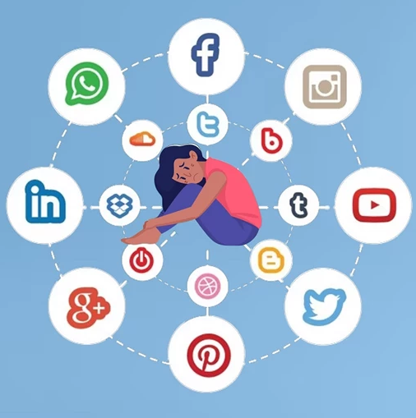
From Likes to Lows
Understanding the Psychological Effects of Social Media Use
Giorgia Faedda
Hoda Nseif
Andrea Herrera
Raghad Al Shalati
Umida Rahmanova
Introduction to Data Analytics

Slide 2
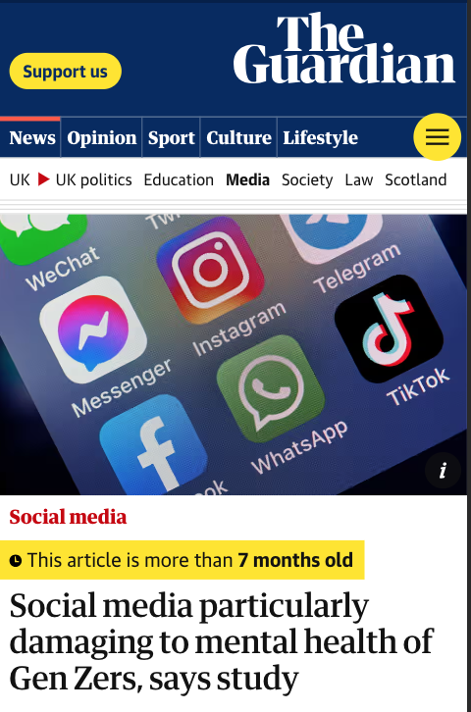
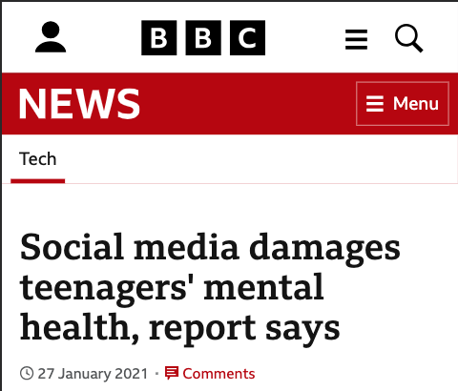
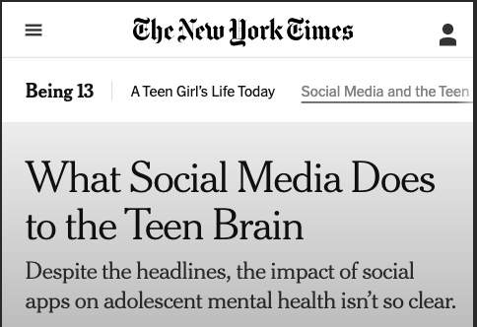
Why this topic?

Slide 3
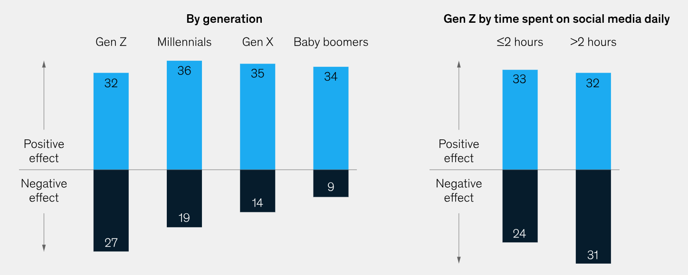
Why this topic?
Research Link: https://bit.ly/46MddSj

Slide 4
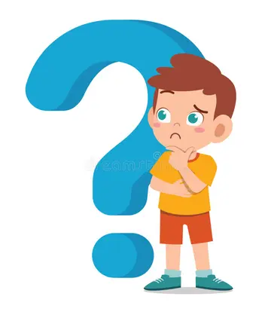
Why this topic?
Is there any real correlation between Social Media and Mental Health?
And what are the consequences of Social Media use?

Slide 5
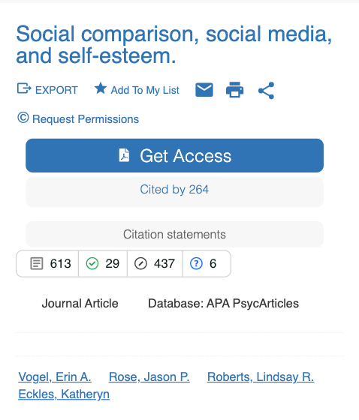
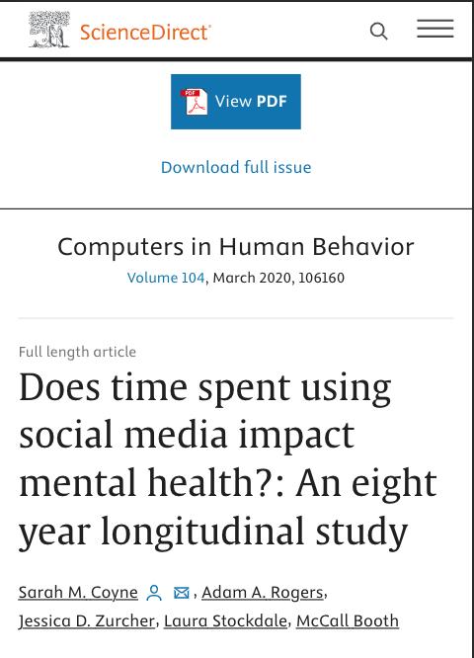
The challenge
Are we going to find the same results as other studies have found?​

Slide 6
Research question
How does social media impact mental health, including self-esteem, anxiety, and depression?

Slide 7

Research
How does social media impact mental health, including self-esteem, anxiety, and depression?
Survey and analysis plan​
Demographic data
Mental health questions

Slide 8
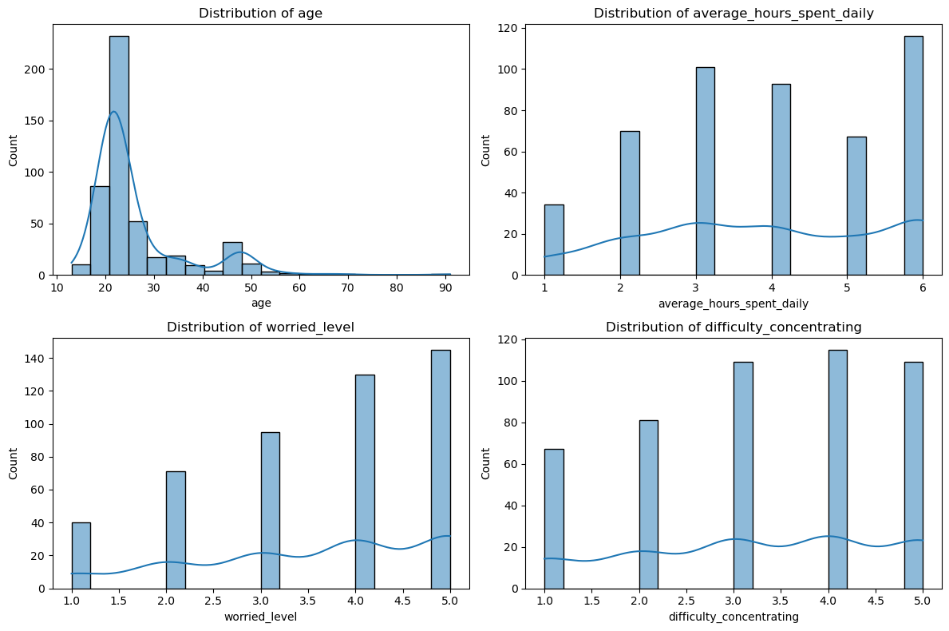
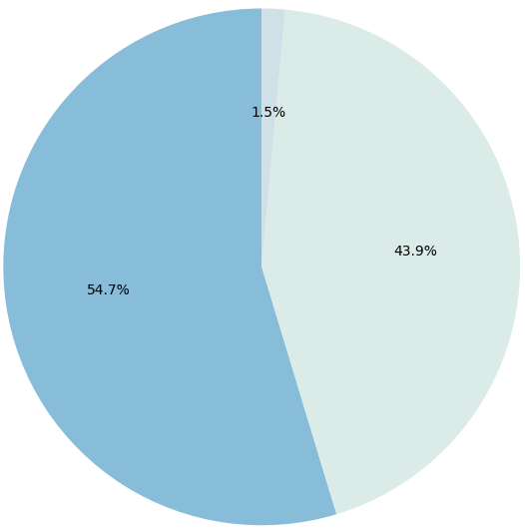
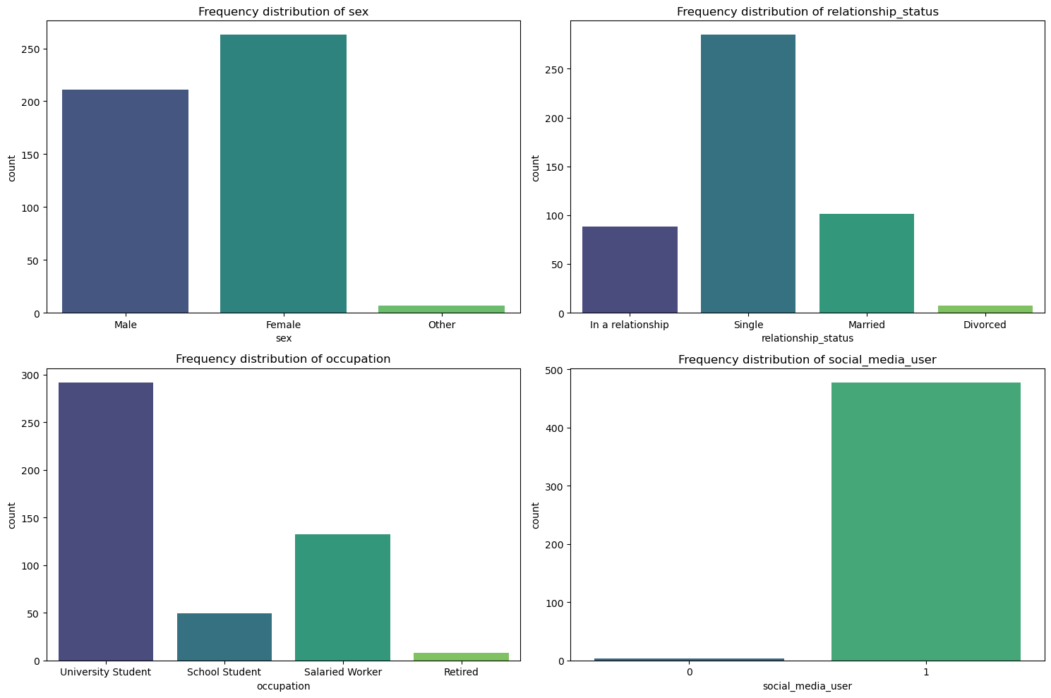
Age Distribution
Time spent on Socials
Our Sample
Sex
Occupation
Female
Male
University
Student
School
Student
Salaried Worker
Retired
Sample size: 481
Mostly young people
Most more than 5 hours daily on platforms
Mostly university students

Slide 9
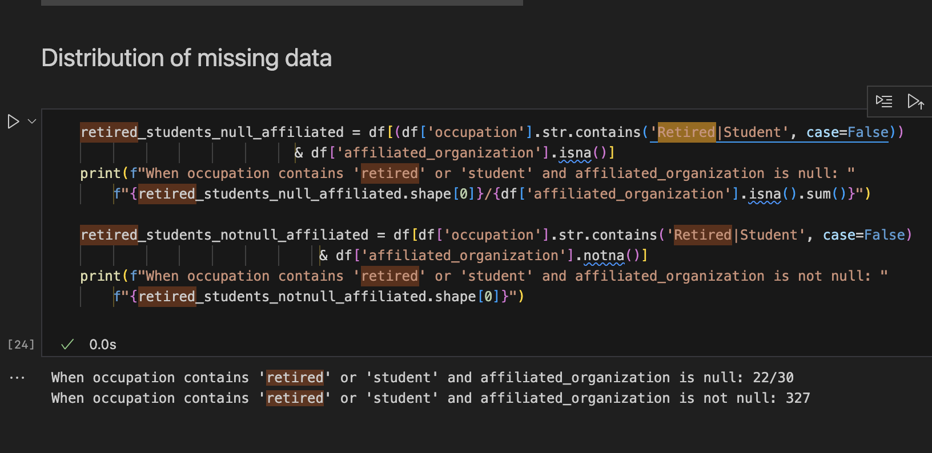
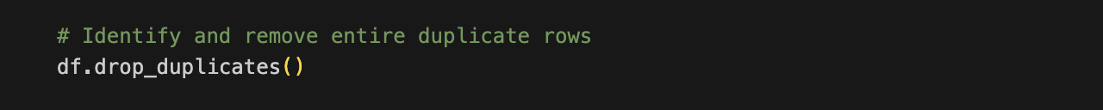
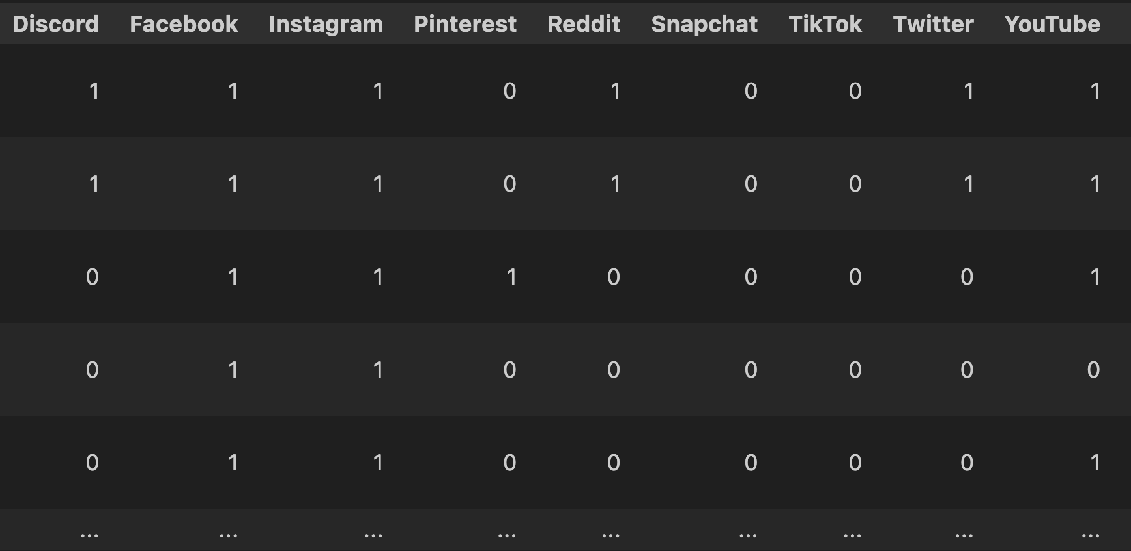
Data cleaning
Handle missing values
Remove duplicates
Encoding

Slide 10
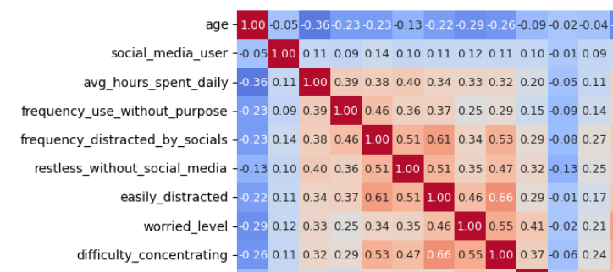
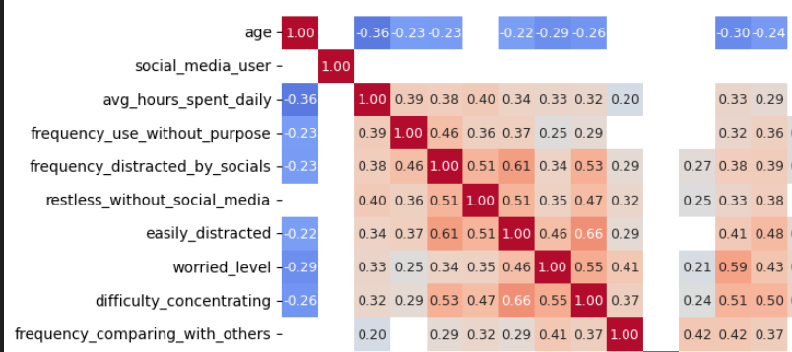
Analysis methodology
Correlation Matrix
Filtering entangled variables
Analysing meaningful correlations

Slide 11
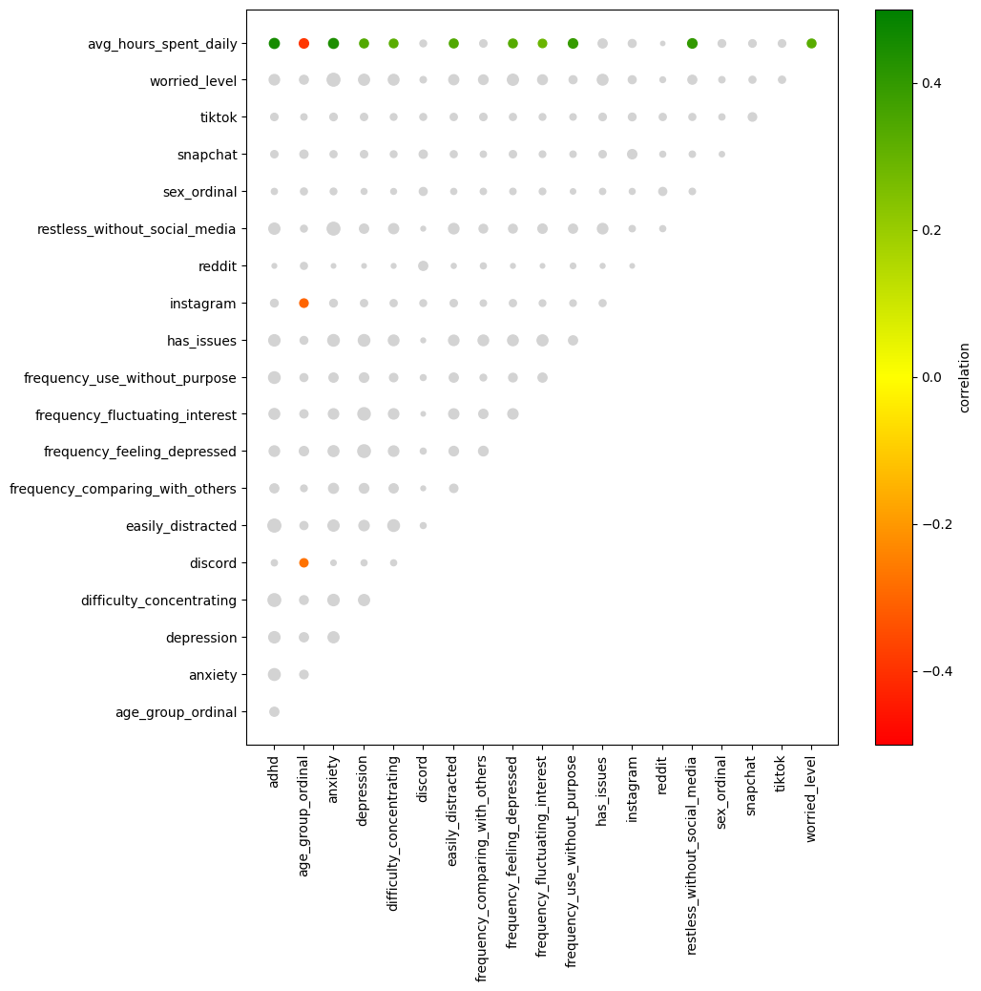
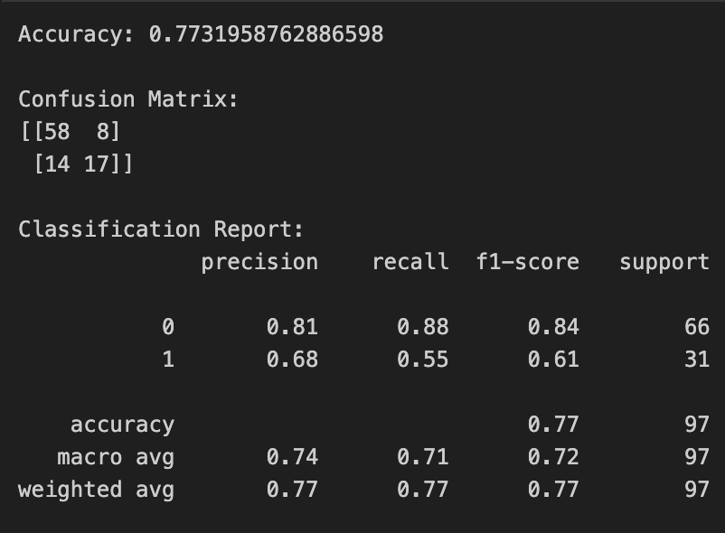
Testing methodology
Model selection and Test Validity
Combination Matrix Logistic Regression
Prediction evaluation with Confusion Matrix

Slide 12
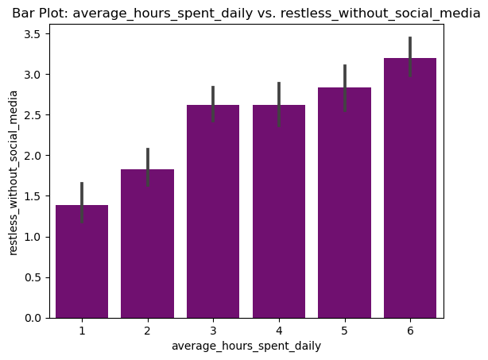
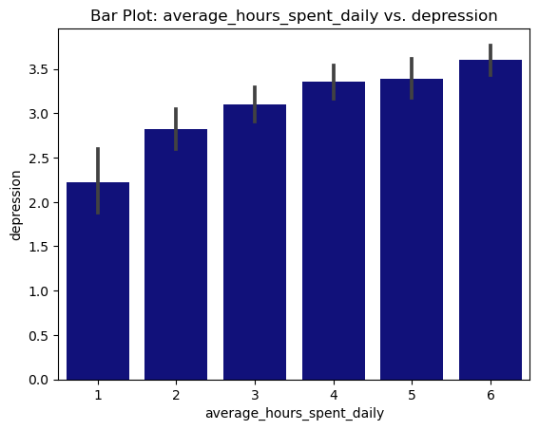
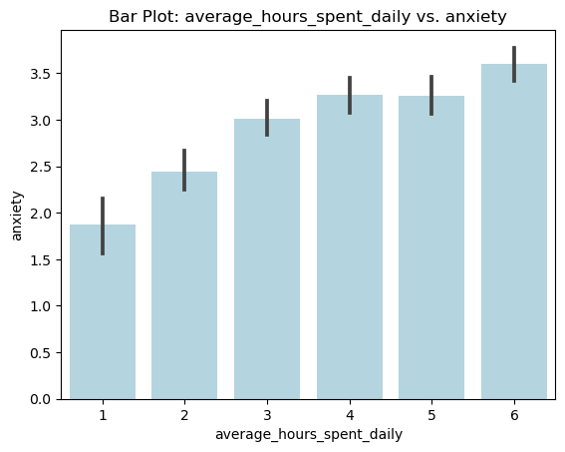
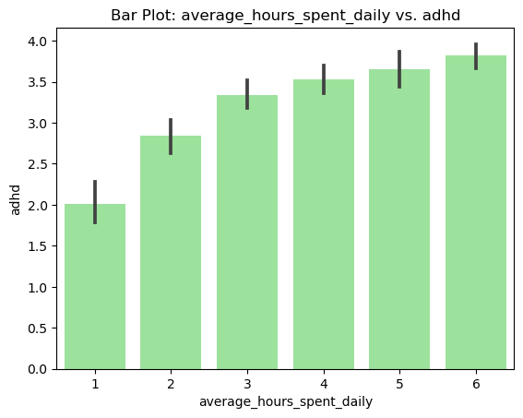
Results
Not significant:
social media platforms and mental health conditions
Significant result:
time spent on social media and mental health conditions

Slide 13
Discoveries
How much matters more than what
Time on socials correlates with:
Anxiety
ADHD
Restlessness

Slide 14
Summary
Does Social Media usage affect Mental Health?
Cleaned, Adapted and Analysed Data to discover patterns
Tested interesting relationships for significance
Spending long time on Social Media is associated with Anxiety, ADHD and restlessness

Slide 15
Conclusions
Research question:
How does social media impact mental health, including self-esteem, anxiety, and depression?

Slide 16

Conclusions
Valuable insights into the dynamics of Social Media and Mental Health
Time spent on Social Media has a significant relationship with Mental Health conditions
Correlation is not causation: caution with the blame game
Do people with Health Conditions use more Social Media? Do Social Media cause Health Conditions? Or is there any additional variable at play?

Slide 17

Future directions
Wider and more varied sample:
many young individuals studying at university
more that 99% being social media users.
Longitudinal studies: analyse long-term effect of usage or withdrawal from socials
Qualitative research: can provide a richer understanding and ideas for further research
Cross-cultural studies: exploring cultural variations that can provide meaningful insights

Slide 18


Questions?
Thank you!
Data Analytics
Giorgia Faedda
Hoda Nseif
Andrea Herrera
Raghad Al Shalati
Umida Rahmanova
From Likes to Lows
Understanding the Psychological Effects of Social Media Use

